Slide 1


Meesho Operations Case Study
Logistics & Seller Onboarding | Consulting-style Analysis

Slide 2

Problem Statement
Logistics Inefficiencies
High fulfillment costs and delivery delays are constraining Meesho's ability to compete with established players like Amazon and Flipkart in the Indian market.
Seller Onboarding Drop-offs
Complex registration processes and lengthy verification procedures result in significant seller attrition during the onboarding journey.
These operational challenges directly impact revenue growth potential and market competitiveness in India's rapidly expanding social commerce sector.

Slide 3

Market Context & Benchmarking
Social Commerce Boom
Competitive Landscape
India's social commerce market is projected to reach $70B by 2025, driven by increasing smartphone penetration and social media adoption in tier-2/3 cities.
Amazon and Flipkart dominate with sophisticated logistics networks. Newer players like Dealshare and BulkMandi are gaining ground with localized approaches.
Infrastructure Gap
Meesho's logistics capabilities lag behind competitors, particularly in last-mile delivery and seller support systems, creating operational bottlenecks.

Slide 4
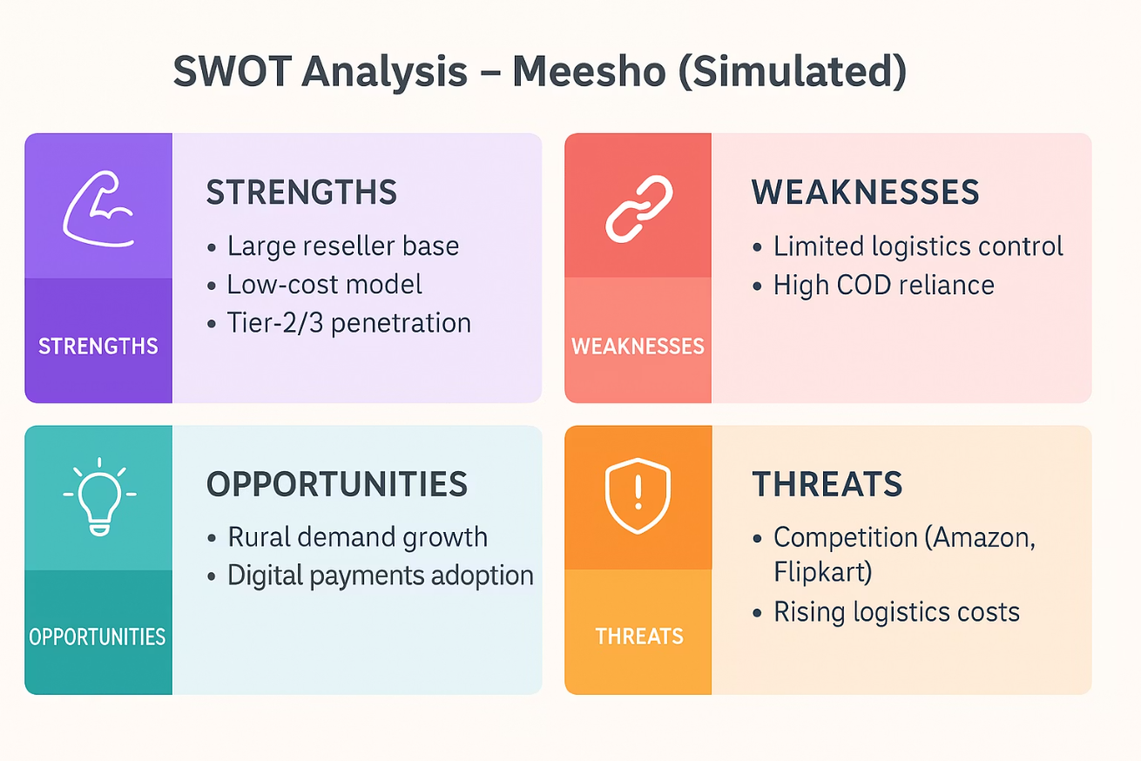
SWOT Analysis
Strength
Oppotunities
Meesho benefits from a huge reseller network, low-cost model, and deep Tier-2/3 market penetration.
There’s rising demand in rural e-commerce and growing adoption of digital payments.
Threats
Weaknesses
Strong competition from Amazon/Flipkart and increasing logistics expenses pose risks.
It struggles with limited control over logistics and heavy reliance on cash-on-delivery.

Slide 5
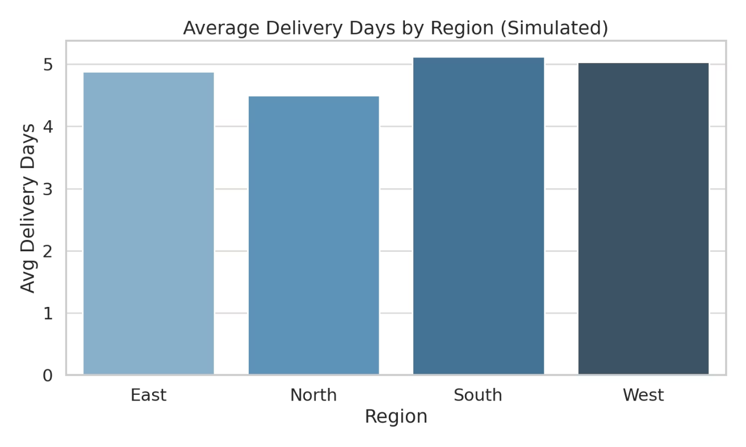
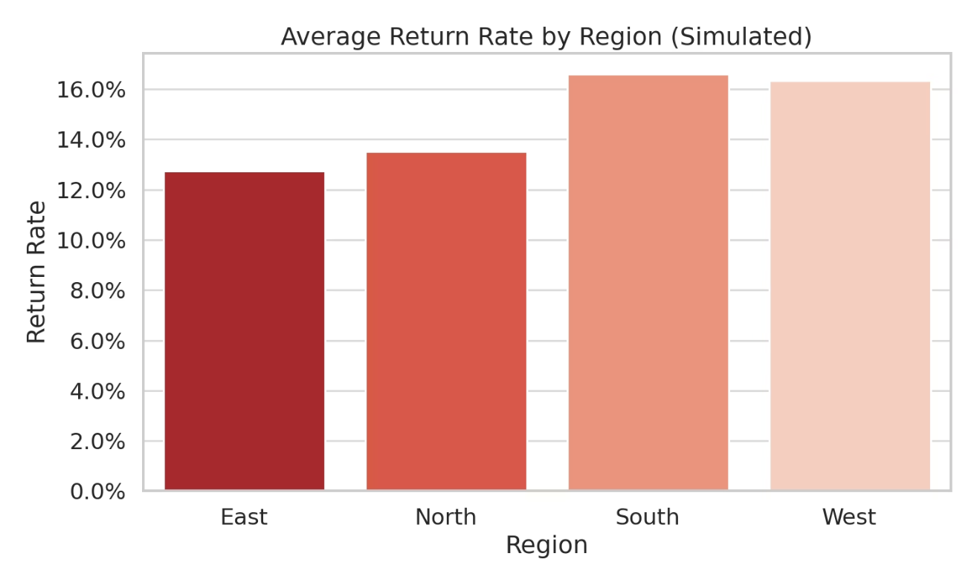
Data Insights
35%
18%
4.2
Seller Drop-off Rate
Higher Logistics Costs
Average Delivery Days
During onboarding process
Versus industry benchmark
Compared to 2.5 for competitors
Seller onboarding completion rates show significant drop-off at verification and documentation stages, indicating process friction points.
Logistics cost analysis reveals inefficiencies in last-mile delivery and warehousing operations compared to industry leaders.

Slide 6

Strategic Recommendations
01
02
Micro-fulfillment Centers
Digital KYC Onboarding
Deploy localized fulfillment hubs in tier-2/3 cities to reduce delivery times and logistics costs while improving seller proximity to inventory.
Implement AI-powered document verification and streamlined digital onboarding to reduce seller drop-off rates and accelerate time-to-market.
03
COD & Returns Optimization
Enhance cash-on-delivery processing and reverse logistics capabilities to improve customer satisfaction and operational efficiency.

Slide 7






Financial Impact & Roadmap
8-10%
20%
6
Logistics Cost Savings
Onboarding Improvement
Months Implementation
Expected reduction through micro-fulfillment optimization
Projected increase in seller completion rates
Timeline for pilot to full-scale deployment
Pilot Phase
Analyze & Optimize
Scale Nationwide
Deploy solutions in 3-5 key markets to validate approach and refine operations
Measure performance metrics and iterate based on initial results and feedback
Roll out proven solutions across all markets with full operational integration

